Slide 1

SUPPLY CHAIN MANAGEMENT PROJECT
EXCELR
4th Group

Slide 2
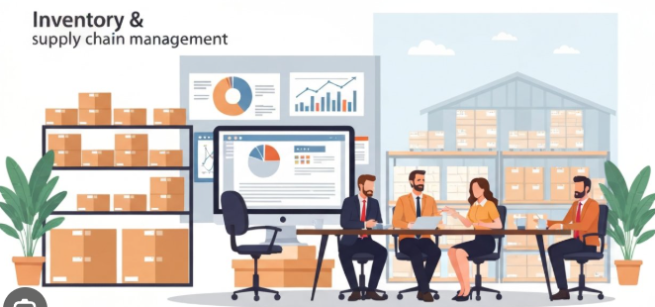
Team Members
Shravani Pravin Bhosale
Velugula Jasmitha
Lekhya Sree
Sudarshan N
Priya Malpani
Megha Sonar S
BAYYAVARAPU MADHU

Slide 3
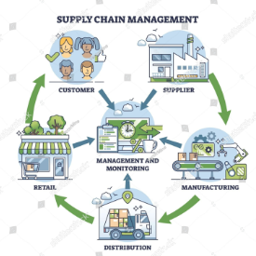

Project Introduction
This project analyzes supply chain management data using Excel, SQL, Tableau and Power BI.
It focuses on understanding sales performance, inventory levels, and demand patterns to support better decision-making.
Project Scope
An end-to-end analysis project covering data cleaning, modelling and visualization.
It includes sales analysis, inventory tracking and performance monitoring across products, stores and regions.
Core Focus Areas
Sales analysis(MTD, QTD, YTD)
Product performance
Inventory management
Sales growth trends
Region & Store analysis

Slide 4

Overview
Project Overview
This project focuses on analyzing end-to-end supply chain data including sales, inventory and regional performance to generate actionable insights. The goal is to monitor key metrics like sales trends, product performance and inventory levels to improve decision-making. By using tools like Excel, SQL, Tableau and Power BI the project helps identify top-performing regions and stores, detect demand patterns and optimize inventory management for better efficiency and profitability.
Key Objectives
Analyze sales and growth trends
Monitor inventory levels
Identify top & underperforming areas
Present insights through dashboards

Slide 5
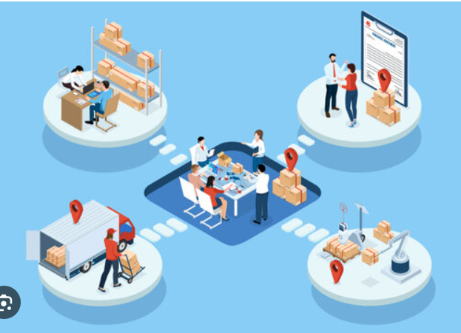

Tools Used

Slide 6


Slide 7
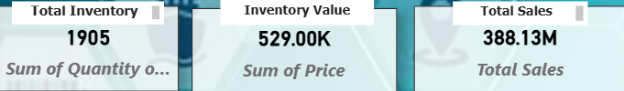
KPIs
Analysis
1. Total Sales (388.13M) Observation: Strong overall revenue, but a sharp drop in 2023 (~26M) indicates declining performance. Solution: Investigate reasons (seasonality, demand drop, supply issues). 2. Total Inventory (1905 Units) Observation: Inventory exists but may not align with demand (based on sales drop). Solution: Implement demand-based inventory planning. 3. Inventory Value (529K) Observation: High inventory value indicates capital tied up in stock. Solution: Optimize stock levels to reduce holding cost.

Slide 8
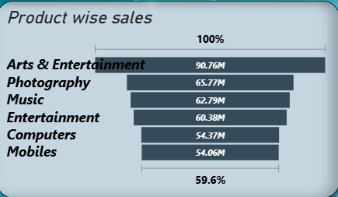
Product wise Sales
Analysis
Observation:
Arts&Enterainemnt (~90) is the top category.
Lower performance in mobiles & computers.
Solution:
Increase marketing and stock for top-selling categories.
Improve low-low performing products with pricing strategies or bundles.
Remove or redesign consistently underperforming products

Slide 9
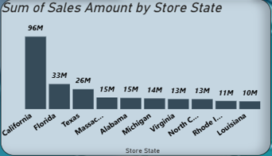
State wise Sales
Analysis
Observation:
California(~96M) dominates sales.
Other states contribute significantly less.
Solution:
Replicate California’s strategy in other states.
Increase marketing and distribution in low-performing states.
Identify region-specific customer preferences.

Slide 10
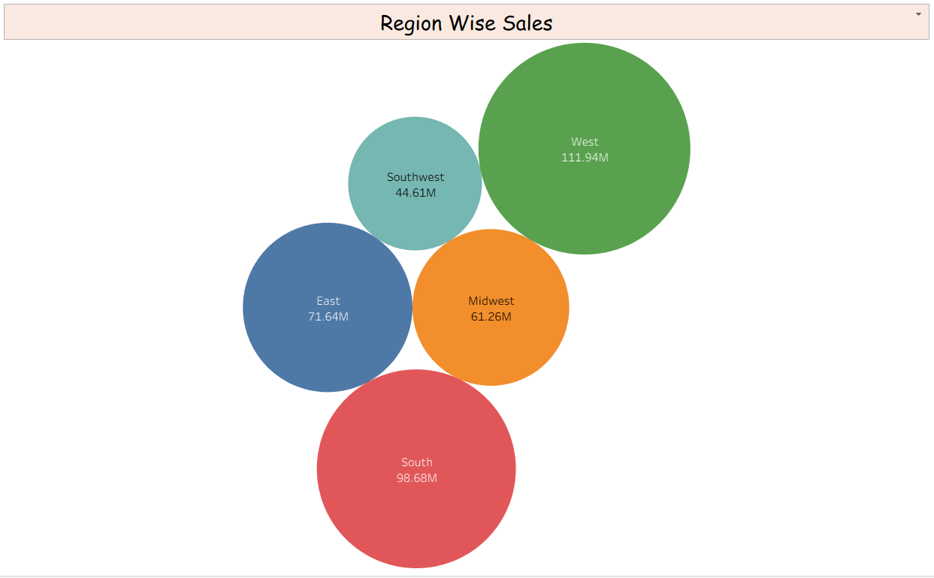
Region wise Sales
Analysis
Observation:
West(111.94M) & South(98.68) are top regions.
Southwest (44.61M) is weakest.
Solution:
Expand operations in strong regions.
Improve logistics and marketing in weak regions.
Use regional demand analysis for targeted strategies.

Slide 11
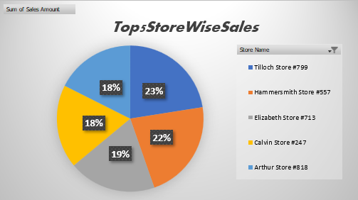
Top 5 Store wise Sales
Analysis
Observation:
Top stores contribute a major share(Tilloch, Hammersmith, etc.)
Sales are concentrated in few stores.
Solution:
Study top store strategies(location, pricing, inventory)
Apply best practices to other stores.
Provide incentives/training for low-performing stores.

Slide 12
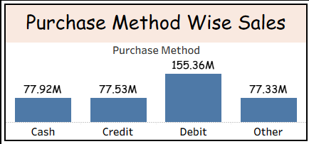
Purchase method wise Sales
Analysis
Observation:
Debit(~155M) dominates.
Cash, Credit and others are almost equal but lower compared to debit.
Solution:
Promote digital payments further(cashback, offers).
Improve online/payment experience.
Encourage credit usage via EMI/offers.

Slide 13
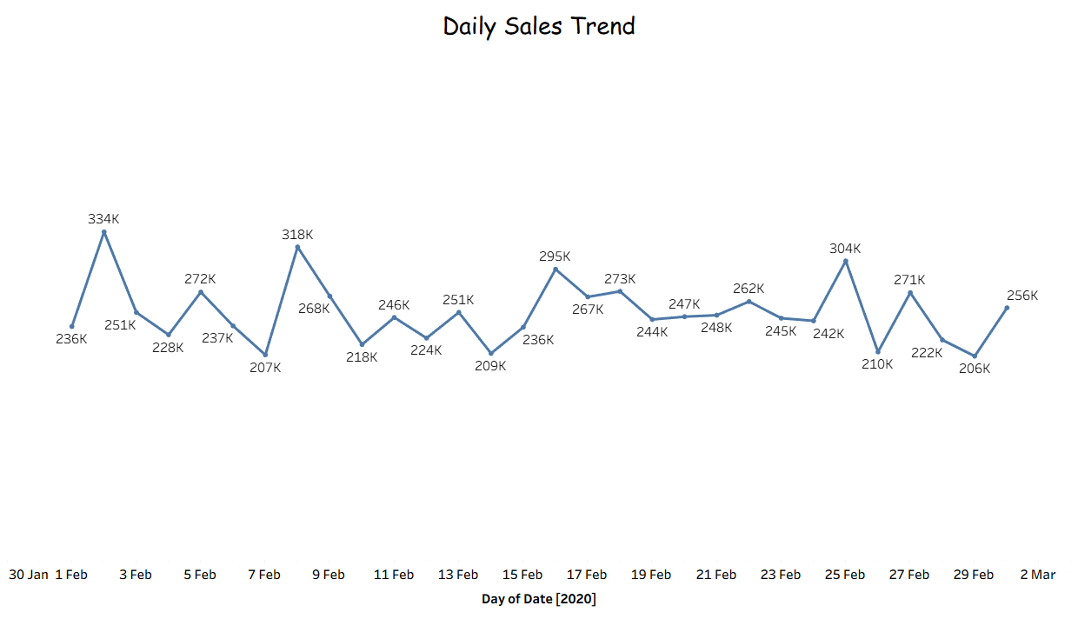
Daily Sales Trend
observations:
Sales show fluctuations with no consistent growth pattern.
Possible spikes and dips indicate demand variability
solution:
Use time-series forecasting for demand prediction.
Plan promotions during low-demand periods.
Ensure consistent supply chain peak demand.

Slide 14
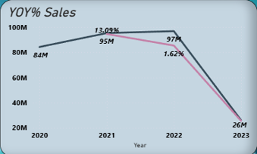
Sales Growth(YOY%)
Observation:
Growth was positive till 2022(~97M) then huge decline in 2023.
Indicates instability in business performance.
Solution:
Analyze external factors(market trends, competition)
Improve demand forecasting
Introduce loyalty programs and customer retention strategies

Slide 15
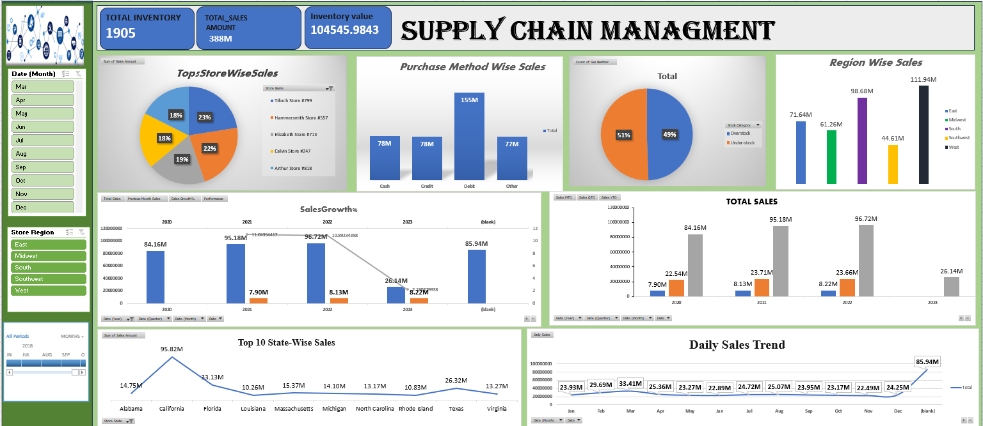
Excel Dashboard

Slide 16
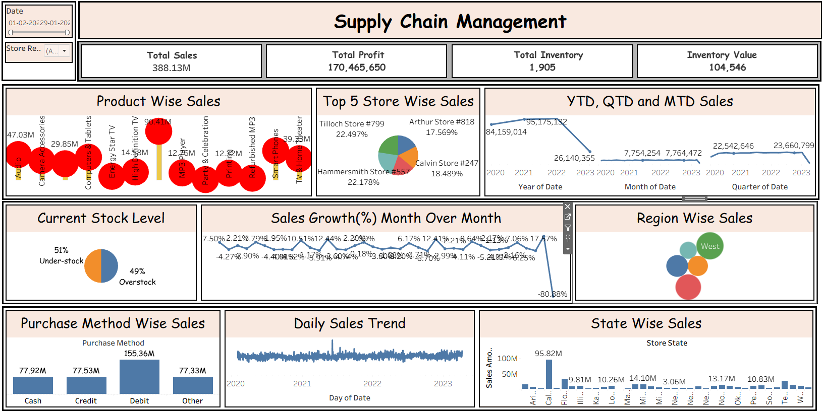
Tableau Dashboard

Slide 17
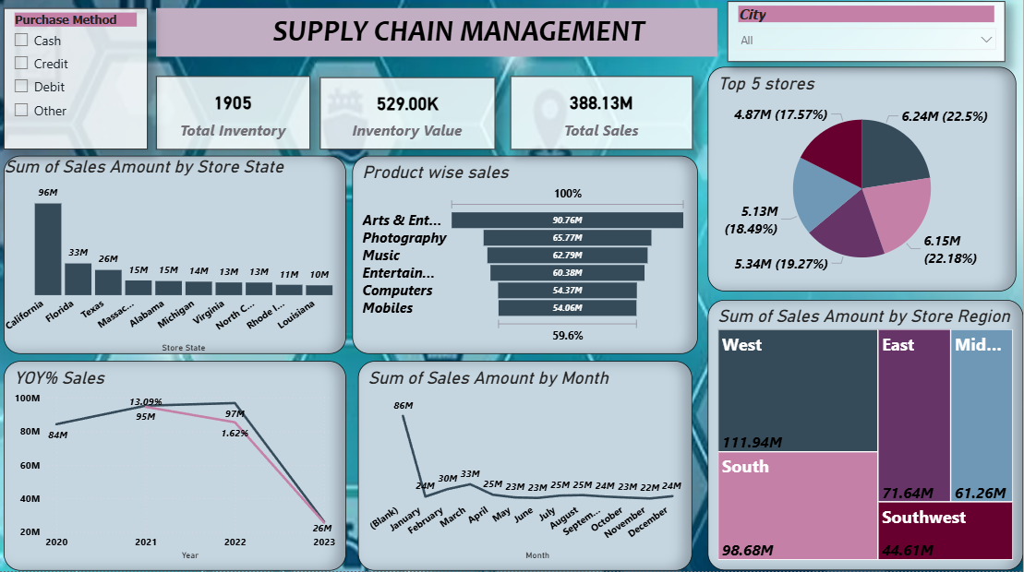
PowerBI Dashboard

Slide 18
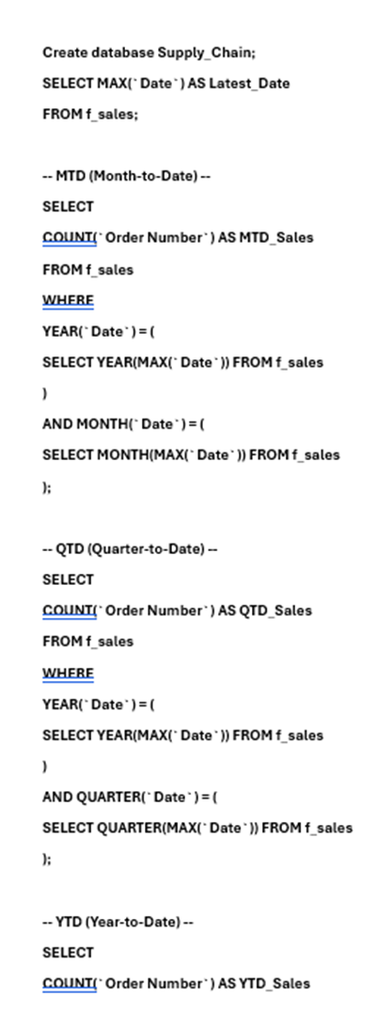
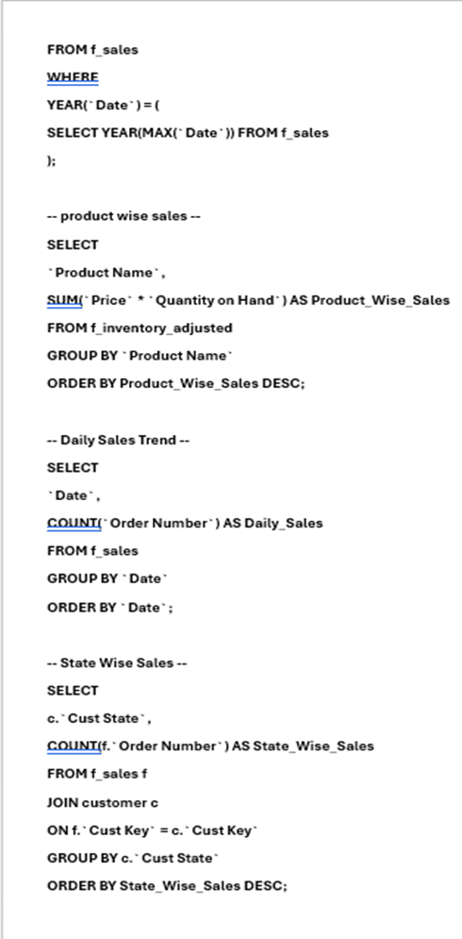
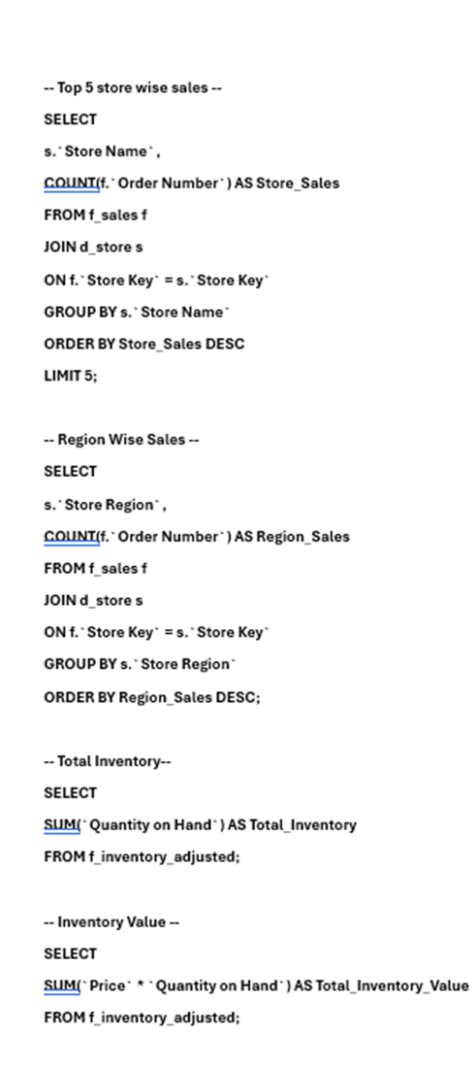
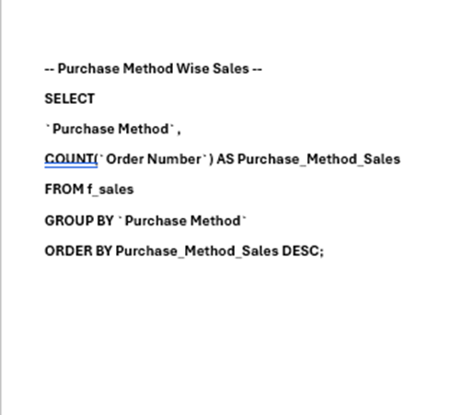
Sql Queries

Slide 19
Conclusion
The project provides clear insights into sales, inventory, and regional performance.
Identifies top-performing products, regions, and stores driving revenue.
Highlights key challenges like declining sales trends and inventory imbalance.
Enables data-driven decisions for better demand forecasting and stock optimization.
Supports improved efficiency, profitability, and overall supply chain performance.

Slide 20
Thank you

